Slide 1
amazon find reviews sentiment analysis
Havens M
Notes:
© Copyright PresentationGo.com – The free PowerPoint library

Slide 2
Agenda
Introduction
Introduction
Exploratory Data
Data wrangling
Modeling
Methodology
Conclusions
Conclusions
Motivation
Data
Inferential statistics
Findings
Modeling framework
Modeling results
Improvements

Slide 3
Introduction
Motivation :
Customers reviews play a crucial factor in the customers’ online shopping processes. As a customer centric company, we want to provide best shopping experiences so our goal of analysis is to classify the review if it is helpful or not helpful. Then customers can have better judgment to make shopping decision.
Data :
1. Time Frame : 2002-2012
2. Observations : 568,454
3. Variables : 9
Data Sources : Link

Slide 4
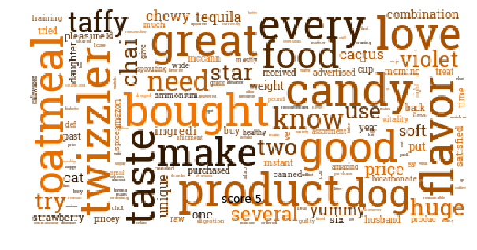
Exploratory Data

Slide 5
Data Exploratory
Insights :
Over 80% of reviews are rated as 4 start or 5 start, positive reviews are very common
Each review contains approximately 80 words.
Reviews with more words are more helpful.
Score rating will impact the reviews' helpfulness.
Top 5 most frequently words in summary reviews
1. Great 2. Good 3.Best 4. Love 5.Coffee
Top 5 most frequently words in reviews text
1. Like 2. Taste 3.Good 4.One 5. flavor

Slide 6
Modeling

Slide 7
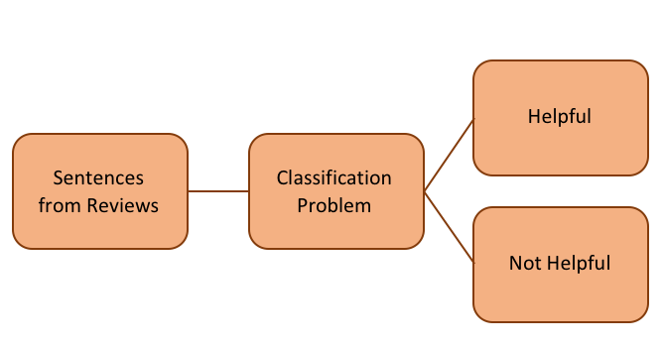
Modeling
Methodology :
Since we have a labelled dataset containing texts and their label is used for train a classifier. This is the text classification and our goal is to build a prediction model where we will be able to predict whether a review is helpful or not helpful.

Slide 8
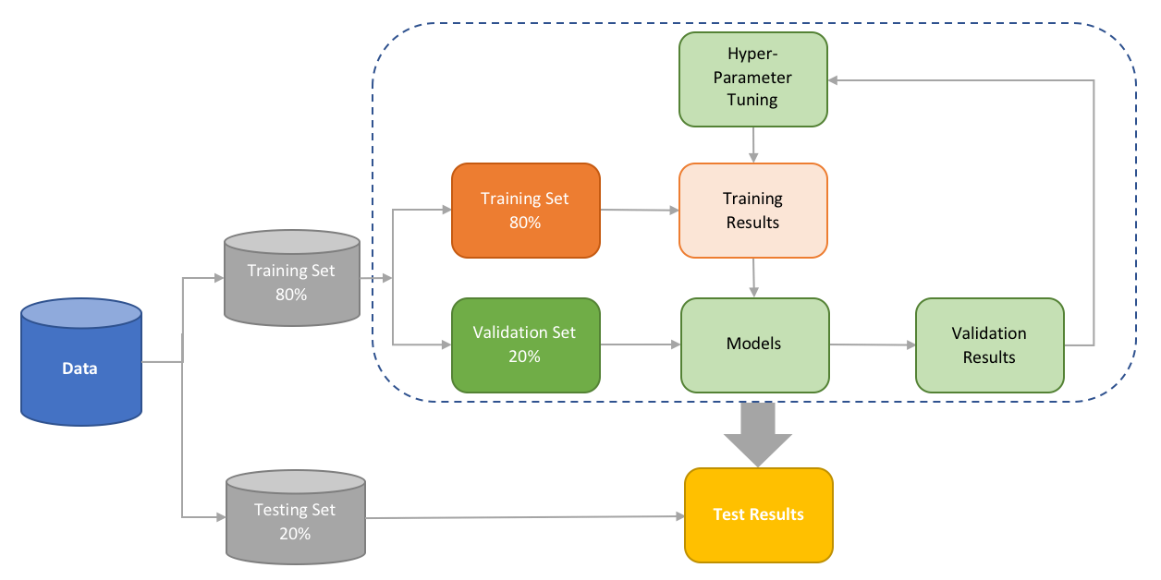
Modeling
Framework:

Slide 9
Modeling
1. Dataset Preparation:
Binary encoding to "1" helpful, "0" helpfulness
Split files into training, validation, testing sets 80% , 20%, 20%
2. Feature Engineering:
Create Sample pipeline for text feature extraction and evaluation
N-gram level TF-IDF
3. Model Training:
Algorithms: Naive Bayes, Logistic Regression, SVM, Random Forest and Ada-boost classifier.
Use a grid search with cross validation to optimize on the hyperparameters of each algorithm.
Select the model with highest accuracy
4. Final model tuning and optimization
4. Improve Performance of Text Classifier: In this article, we will also look at the different ways to improve the performance of text classifiers

Slide 10
Conclusions

Slide 11
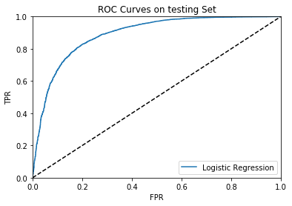
Conclusions
We can observe that the area under the curve(AUC) is equal to 0.89. We can conclude that our Logistic Regression model has learned to distinguish helpful and nonhelpful reviews.

Slide 12
Conclusions (cont.)
Results :
The average ROC score for 100 different random states is equal to 0.89, the same as our optimum solution. We can consider this model is robust.
The final F1 score is equal to 0.83 and the precision and recall are also very close . It indicates our model has a good balance between sensitivity and specificity
 | precision | recall | F1-score | Support
0 | 81% | 62% | 70% | 4,148
1 | 85% | 93% | 89% | 9,255
Avg/Total | 83% | 84% | 83% | 13,403

Slide 13
Conclusions (cont.)
Improvement :
To improve the accuracy of our model, the following actions could be taken:
1. Text cleaning : Conduct different ways to clean text will help to reduce noise.
2. Feature engineering : Generate different different feature vectors (Ex: Character Level TF-IDF) or add NLP based features (Average Word Density of the reviews, Word Count of the reviews)
3. Trained in a variety of classifiers (Ex : Deep Neural Networks Convolutional Neural Network (CNN)/ Recurrent neural networks (RNN))

Slide 14
Thank You

